Slide 1

Smart water management
Name :p.sathishkumar
Reg no:422121106030
Nm id:au422121106030

Slide 2
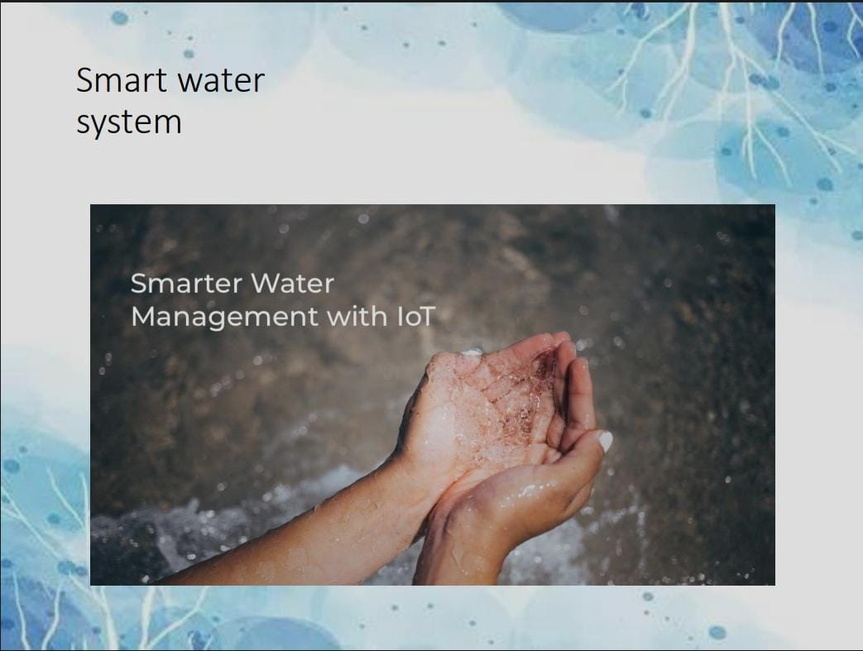
....

Slide 3
Innovation of project
In this technology project you will continue building your project by developing the platform as per
project requirement. Use web development technologies wherever needed. After performing the
relevant activities create a document around it and share the same for assessment.

Slide 4
....
In phase 3 I included simulation project to conserve the water
In phase 4 I further develop the project I like to including two sensor with net diagram
Temperature
Humidity

Slide 5
Introduction of project
let's talk about smart water management! Smart water management refers to the use of technology and data-driven approaches to optimize the use and conservation of water resources. It involves the integration of sensors, meters, and data analytics to monitor water usage, detect leaks, and improve efficiency in water distribution systems. By implementing smart water management solutions, we can better understand water consumption patterns, identify areas of improvement, and make informed decisions to ensure sustainable water management. Let me know if you have any specific questions or if there's anything else I can assist you with.

Slide 6
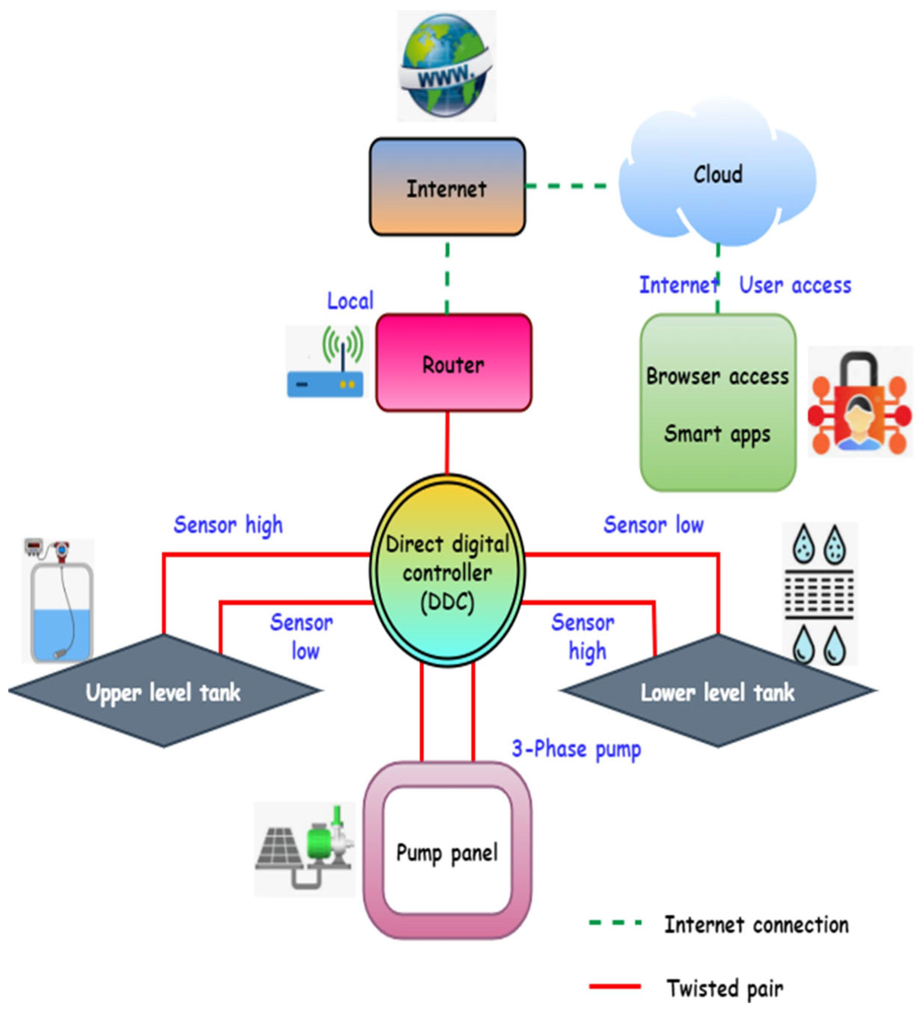
Smart water management diagram

Slide 7
Program for temperature
#include <stdio.h>
#include <stdlib.h>
#include <time.h>
Flood readTemperature() {
return 25.5;
}
int main() {
float temperature = readTemperature();
time_t rawtime;
struct tm *timeinfo;
time(&rawtime);

Slide 8
....
timeinfo = localtime(&rawtime);
printf("Timestamp: %s", asctime(timeinfo));
printf("Temperature: %.2f°C\n", temperature);
return 0;}

Slide 9
Program for humidity
#include <stdio.h>
#include <stdlib.h>
#include <time.h>
float readWaterHumidity() {
return 45.3;
}
int main() {
float humidity = readWaterHumidity();
time_t rawtime;

Slide 10
....
struct tm *timeinfo;
time(&rawtime);
timeinfo = localtime(&rawtime);
printf("Timestamp: %s", asctime(timeinfo));
printf("Water Humidity: %.2f%%\n", humidity);
return 0;}

Slide 11
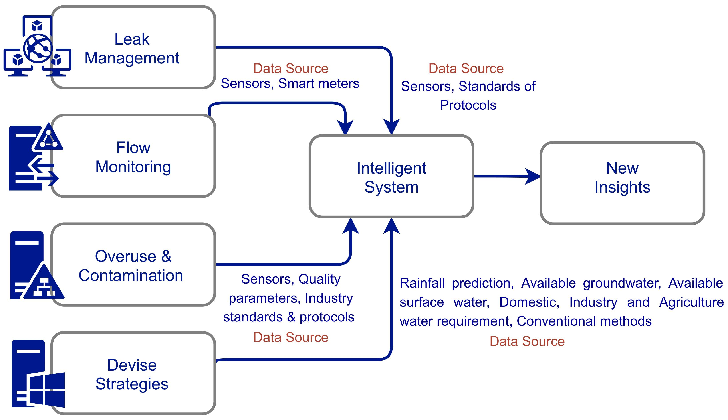
Flow chart

Slide 12
Related work
In terms of smart water management related work, there are various tasks that can be involved. This can include implementing sensor networks to monitor water quality and quantity, analyzing data to identify patterns and anomalies, optimizing water distribution systems to reduce leaks and wastage, and implementing smart irrigation systems for efficient water usage in agriculture. Additionally, there may be work involved in developing and maintaining the technology infrastructure required for smart water management. Let me know if you have any specific questions or if there's anything else I can assist you with.

Slide 13
Conclusion
In conclusion, smart water management is a technology-driven approach that aims to optimize the use and conservation of water resources. By integrating sensors, data analytics, and efficient systems, we can monitor water usage, detect leaks, and improve overall water management. This helps in reducing wastage, ensuring sustainability, and promoting efficient water distribution. If you have any more questions or need further information.

Slide 14

...

